Slide 1

Stock Price Prediction
TEAM MEMBERS:
SUMIT KUMAR MODI
SHAKTI SHARMA
Group : G-11
under the guidance of:
Mr. Santosh kumar gupta

Slide 2
INTRODUCTION
The "Stock Price Prediction using Python" project represents a comprehensive solution to one of the most compelling challenges in the financial world – predicting stock prices with precision and insight. This introduction provides an overview of the project's primary objective, its significance, and how it aims to meet the demands of modern investors and financial professionals.
The "Stock Price Prediction using Python" project is designed to harness the power of data and machine learning to provide investors with actionable insights. It leverages historical stock market data, applying various machine learning algorithms and Python programming to analyze and interpret this data. By doing so, it offers forecasts for future stock prices and identifies potential investment opportunities.

Slide 3
OBJECTIVE
To predict the stock price very accurately using machine learning model.
To overcome and decrease the risk of financial loss.

Slide 4
NEED OF THE PROJECT
The need for stock price prediction tools is paramount in today's fast-paced financial markets. Investors and traders require reliable forecasts to minimize risks and maximize returns. This project addresses the need for accurate, data-driven predictions that can guide investment strategies. It also helps in understanding market sentiment and trends, making it a valuable tool for financial decision-makers.

Slide 5
REQUIREMENTS
Hardware:
Processor: Dual core or above
RAM: 2GB or above
Disk Space: 120MB or above
Software:
Backend:
Python
Data manipulation libraries (Pandas, NumPy)
Machine learning libraries (TensorFlow)
Data visualization libraries (Matplotlib)
Web framework (Flask for web-based deployment)
Database (MySQL)
Frontend:
HTML
CSS
JAVASCRIPT

Slide 6
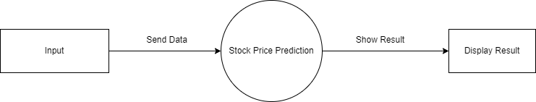
SYSTEM DESIGN
Level 0 DFD:
The Level 0 DFD is an overview of the entire system and showcases the main processes and data sources without delving into their internal workings. It offers a high-level perspective on how data flows throughout the system.

Slide 7
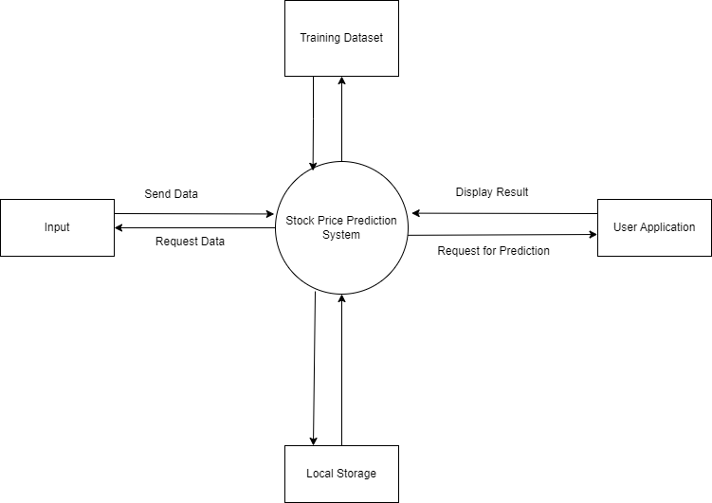
Level 1 DFD:
The Level 1 DFD dives deeper into the processes outlined in the Level 0 DFD, breaking them down into more detailed sub-processes.

Slide 8
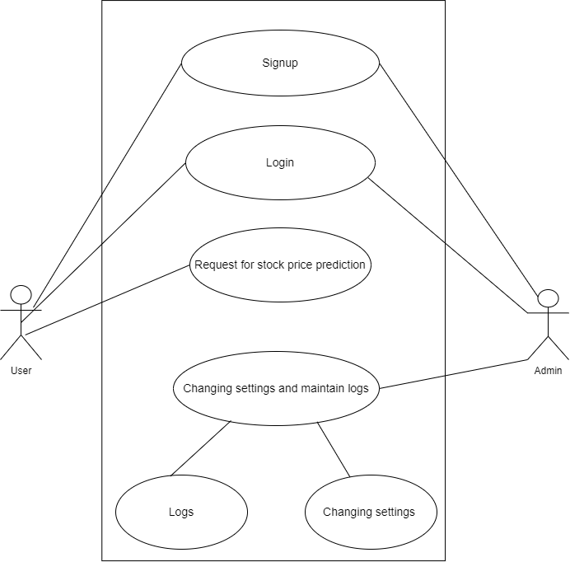
USE CASE DIAGRAM
The purpose of use case diagram is to capture the dynamic aspect of a system.

Slide 9
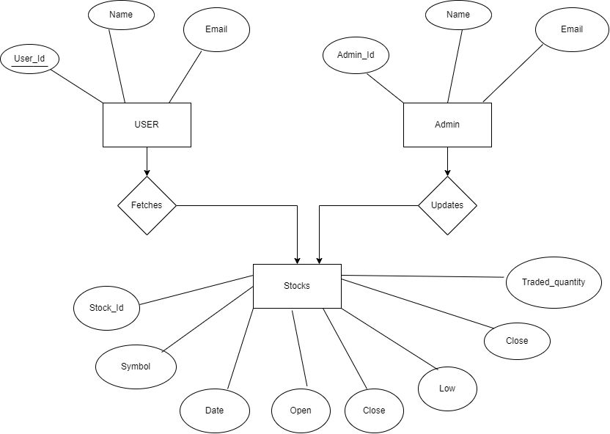
ER DIAGRAM

Slide 10
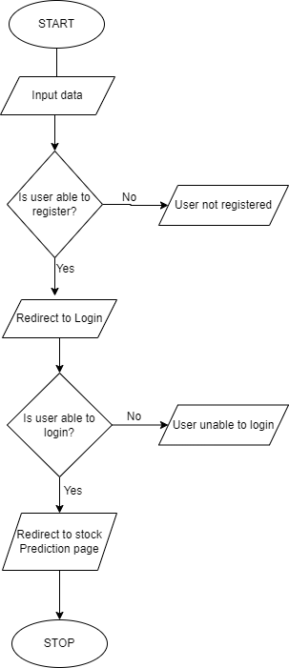
PROCESS FLOW CHART

Slide 11
REFERENCES
www.google.com
www.researchgate.net
www.scribd.com
www.youtube.com

